Slide 1
Programming Assignment #3 CPU Scheduling
202035510 김유현

Slide 2
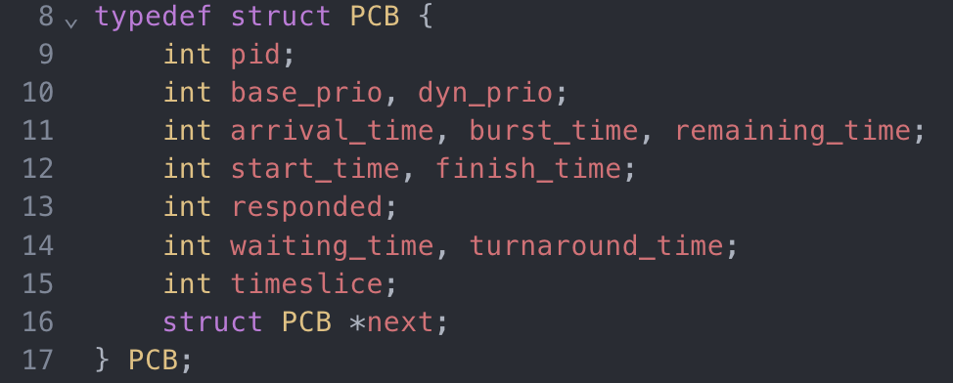
Data Structure
Process Control Block
pid: Unique process identifier
base_prio: Static priority provided in input
dyn_prio: Dynamic priority
arrival_time: Time when process enters the system
burst_time: Total CPU time required
remaining_time: CPU time still needed
start time: Time when process first run
finish_time: Time when process completes
responded: Check process ever run
waiting_time: Total time spent waiting in ready queue
turnaround_time: Finish_time – arrival_time
timeslice: Time used in current RR quantum
struct PCB *next: Pointer to next PCB in ready queue

Slide 3
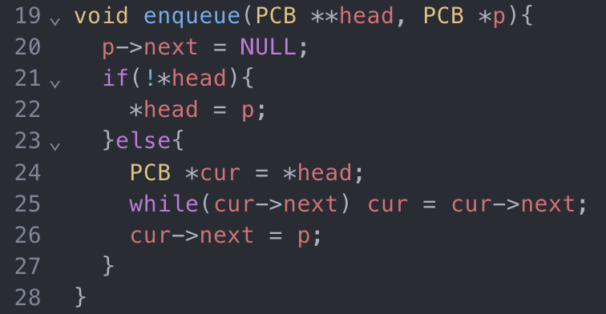
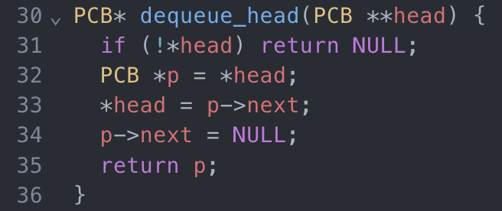
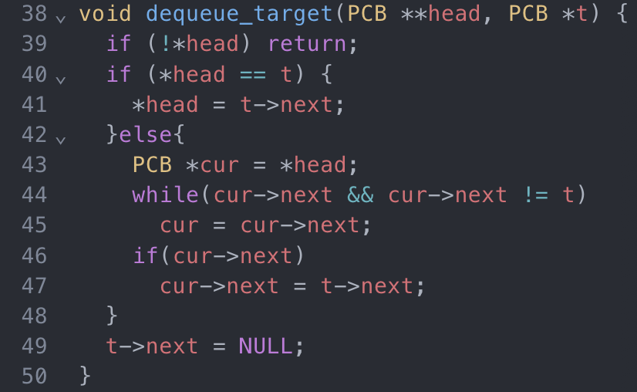
Function
enqueue()
- Manage the ready queue
Insert process p at the end of the queue
O(n) to traverse to end if queue is non-empty
dequeue_head()
Removes and returns the head of the queue
Returns NULL if empty
dequeue_target()
Removes a specific node ‘t’ anywhere in the queue
Updates pointers to splice it out

Slide 4
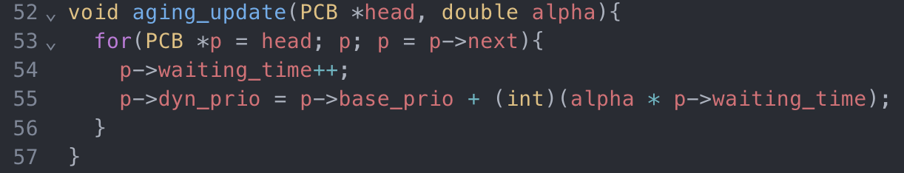
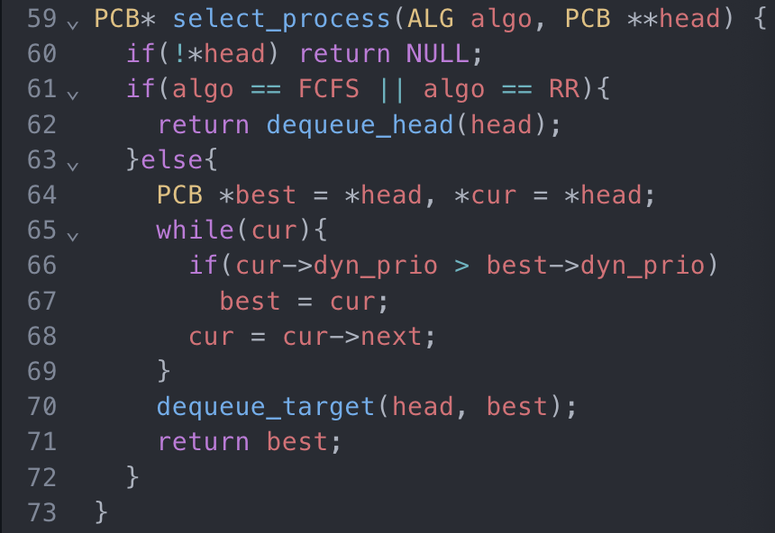
Function
aging_update()
Aging to avoid starvation in priority scheduling
Iterates the entire ready list
Increments each ‘waiting_time’ by 1
Recomputes ‘dyn_prio = base_prio + (int)(alpha * waiting_time)’
Select_process()
- Choose the next process to run
FCFS & RR: Simply remove the head by ‘dequeue_head()’
Prior: Scan for the highest ’dyn_prio’, remove it with ‘dequeue_target()’ and return it

Slide 5
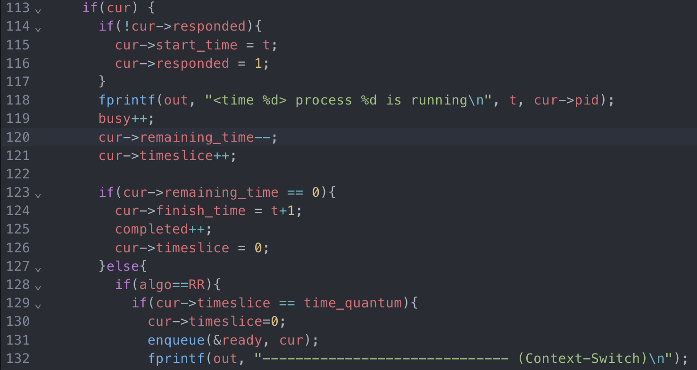
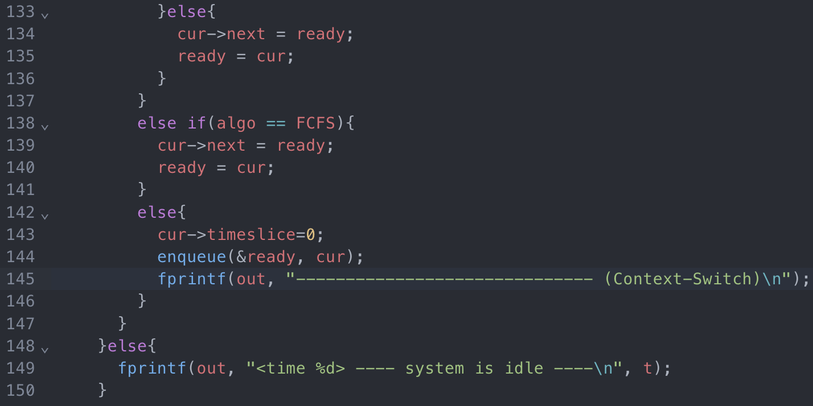
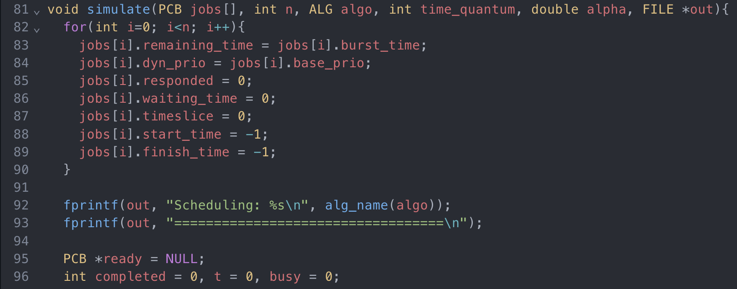
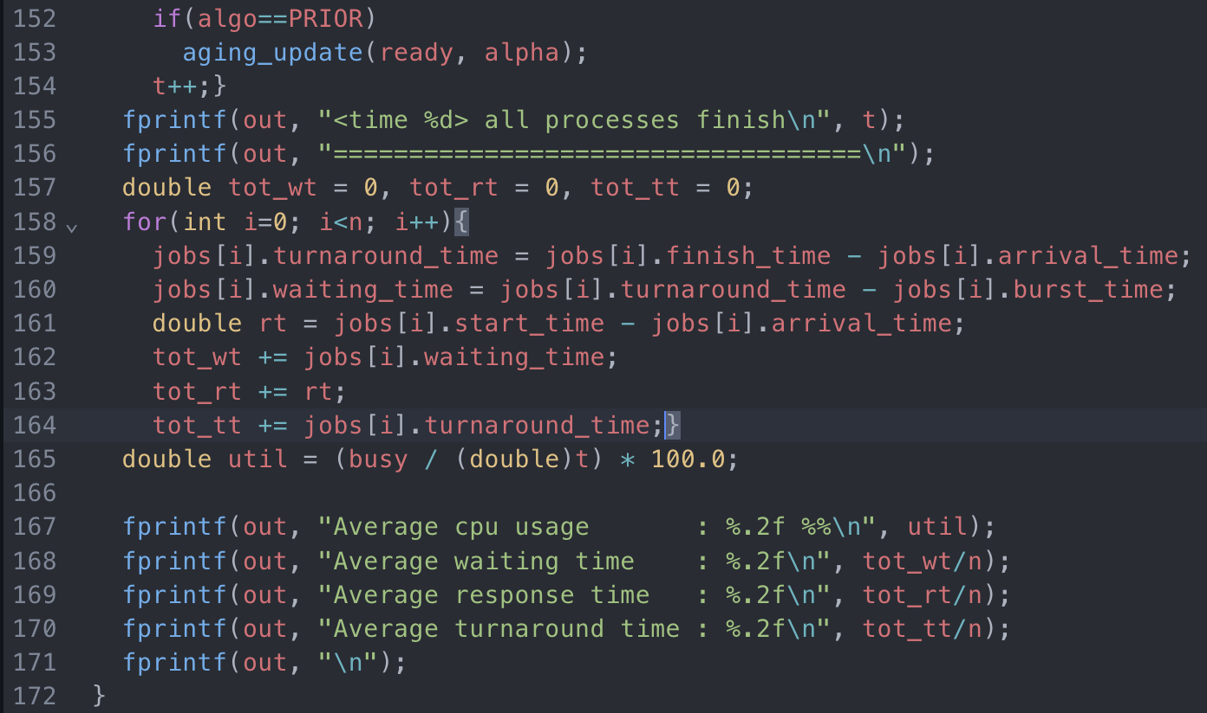
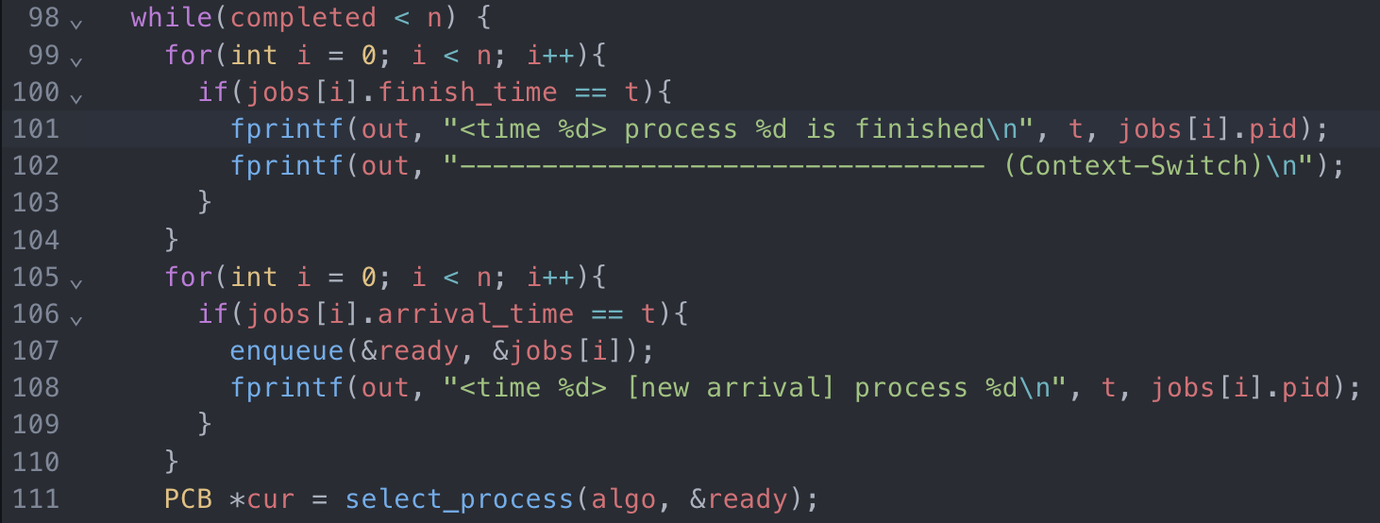
Function
Simulate()
Run the time-driven simulation for one algorithm
Initilaization: Reset each jobs[i] field
Time Loop
Logging
Statistics: For each job compute, CPU utilization

Slide 6
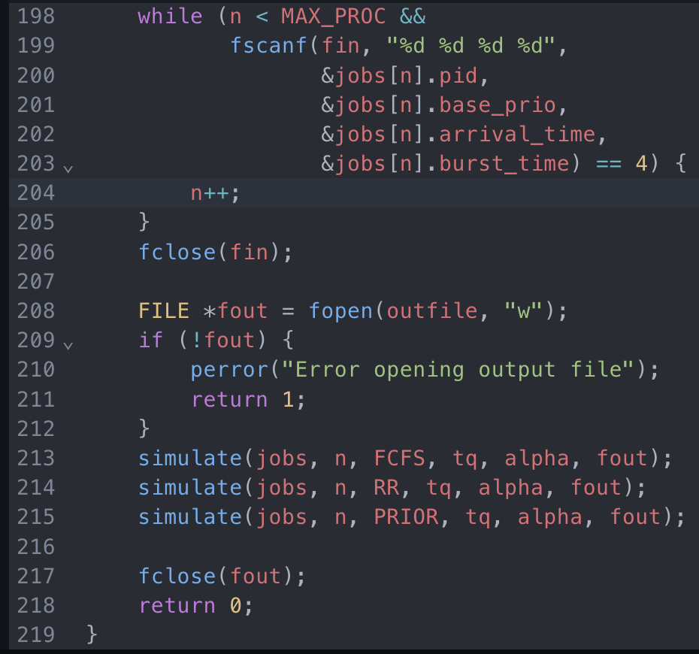
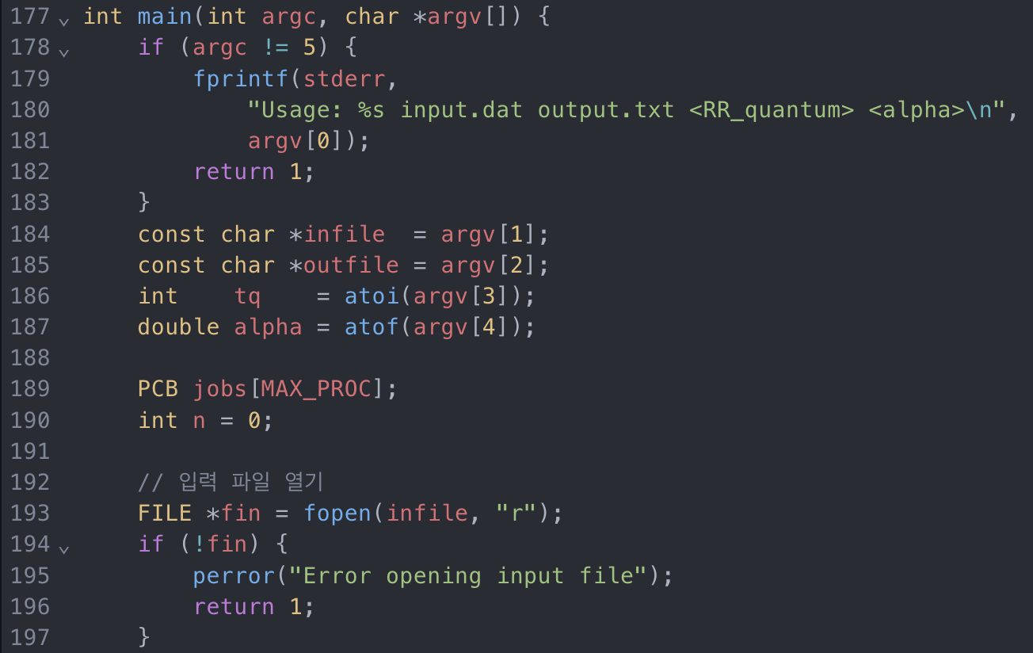
Function
main()
Parse command line arguments: ‘/scheduler input.dat output.txt <RR_quantum> <alpha>
Read input file
Open output file
Call simulate() in sequence for FCFS, RR, Preemptive Priority
Close Files and exit

Slide 7
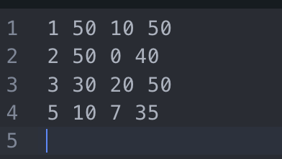
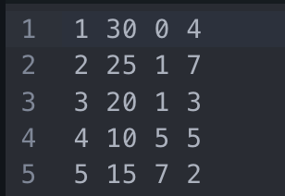
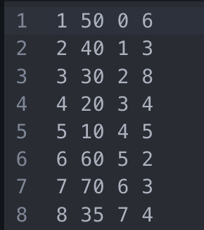
Screen Capture of Execution
Case1
- input.dat1
Execution Example
Case2
input.dat2
Execution Example
Case3
input.dat3
Execution Example

Slide 8
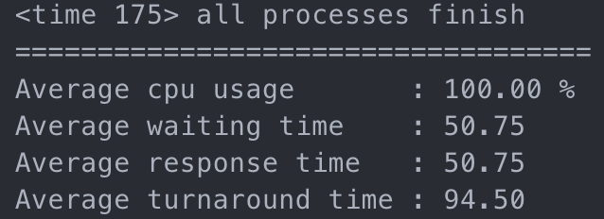
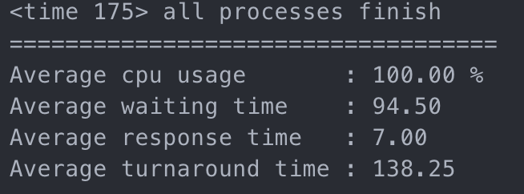
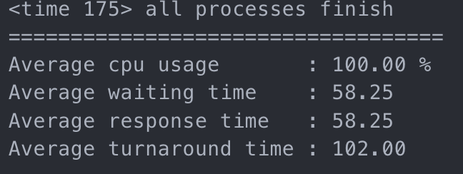
Performance Results – Case1
- FCFS
RR
- Preemptive Priority
<Conclusion>
 | FCFS | RR | Preemptive Priority
AVG Waiting time | 50.75 | 94.50 | 58.25
AVG Response time | 50.75 | 7.00 | 58.25
AVG Turnaround time | 94.50 | 138.25 | 102.00

Slide 9
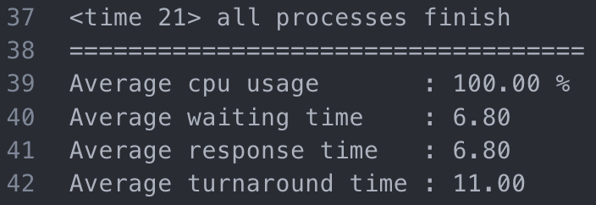
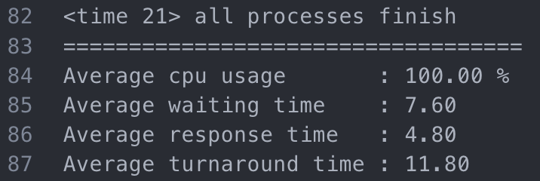
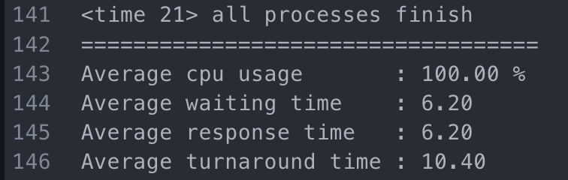
Performance Results – Case2
- FCFS
RR
- Preemptive Priority
<Conclusion>
 | FCFS | RR | Preemptive Priority
AVG Waiting time | 6.80 | 7.60 | 6.20
AVG Response time | 6.80 | 4.80 | 6.20
AVG Turnaround time | 11.00 | 11.80 | 10.40

Slide 10
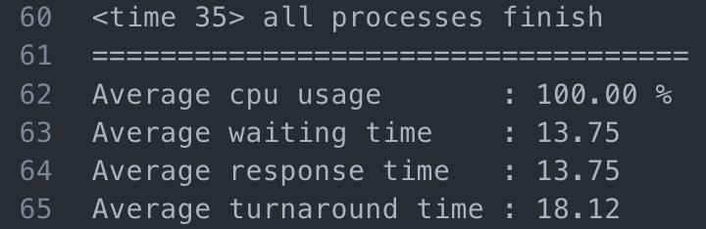
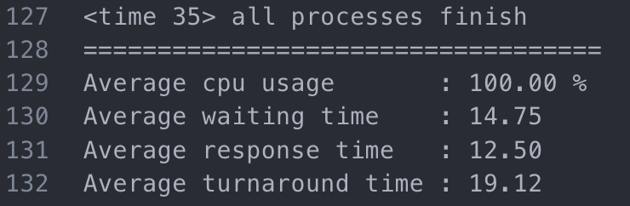
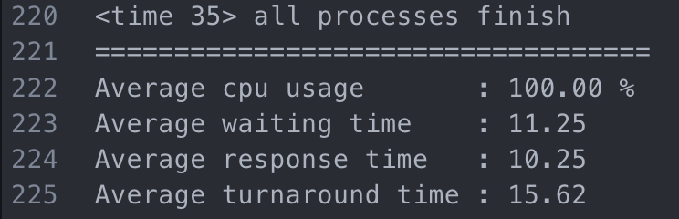
Performance Results – Case3
- FCFS
RR
- Preemptive Priority
<Conclusion>
 | FCFS | RR | Preemptive Priority
AVG Waiting time | 13.75 | 14.75 | 11.25
AVG Response time | 13.75 | 12.50 | 10.25
AVG Turnaround time | 18.12 | 19.12 | 15.62

